Slide 1
CUDA
BY> Guillermo De Mendoza

Slide 2
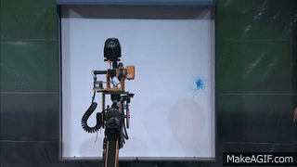
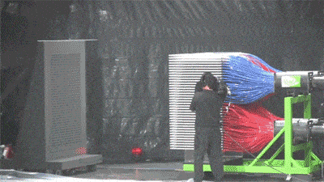
CPU vs GPU
Central processing unit
Versatil
1 to 30 cores
Low latency GHz
Serial
Graph processing unit
Only some task (vectors)
100s to 10000s cores
High throughput (MHz)
Parallel

Slide 3
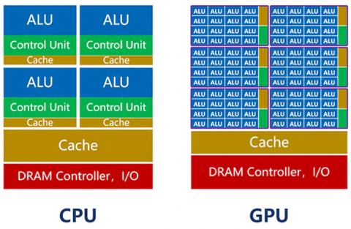
Architecture comparison
ALU: Arithmetic Logic Unit
Control Unit:
Search instructions
Decode instructions
Control executions
Manage flows *by buss
Synchronize
Cache:
Contain instructions
Data access
L1 -> L2 -> L3 -> RAM

Slide 4
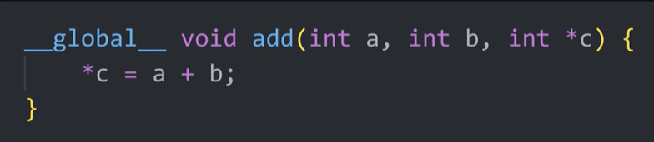
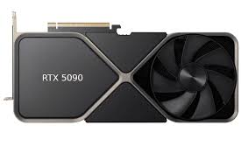
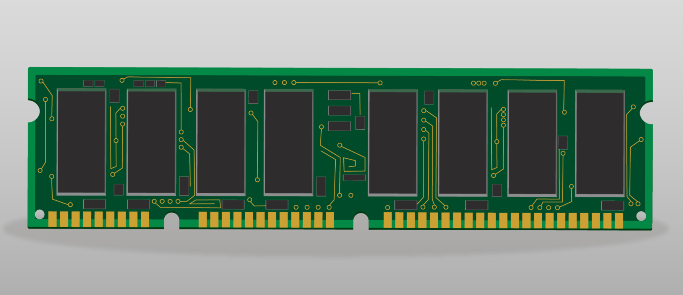
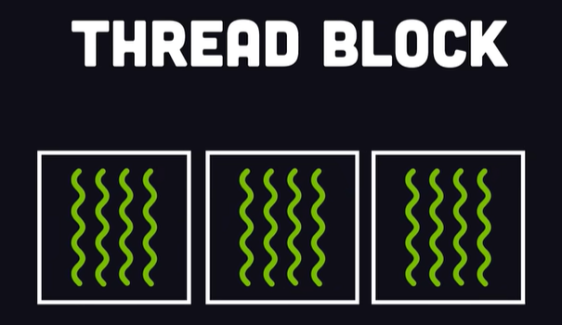
CUDA
CUDA (Compute Unified Device Architecture) is an architecture for parallel computing, developed by NVIDIA in 2007, that leverages the power of its GPUs for general-purpose processing (not only graphical). It uses a hierarchy of grids, thread blocks, and threads to execute tasks in parallel, significantly speeding up compute-intensive application.
load
data
result

Slide 5
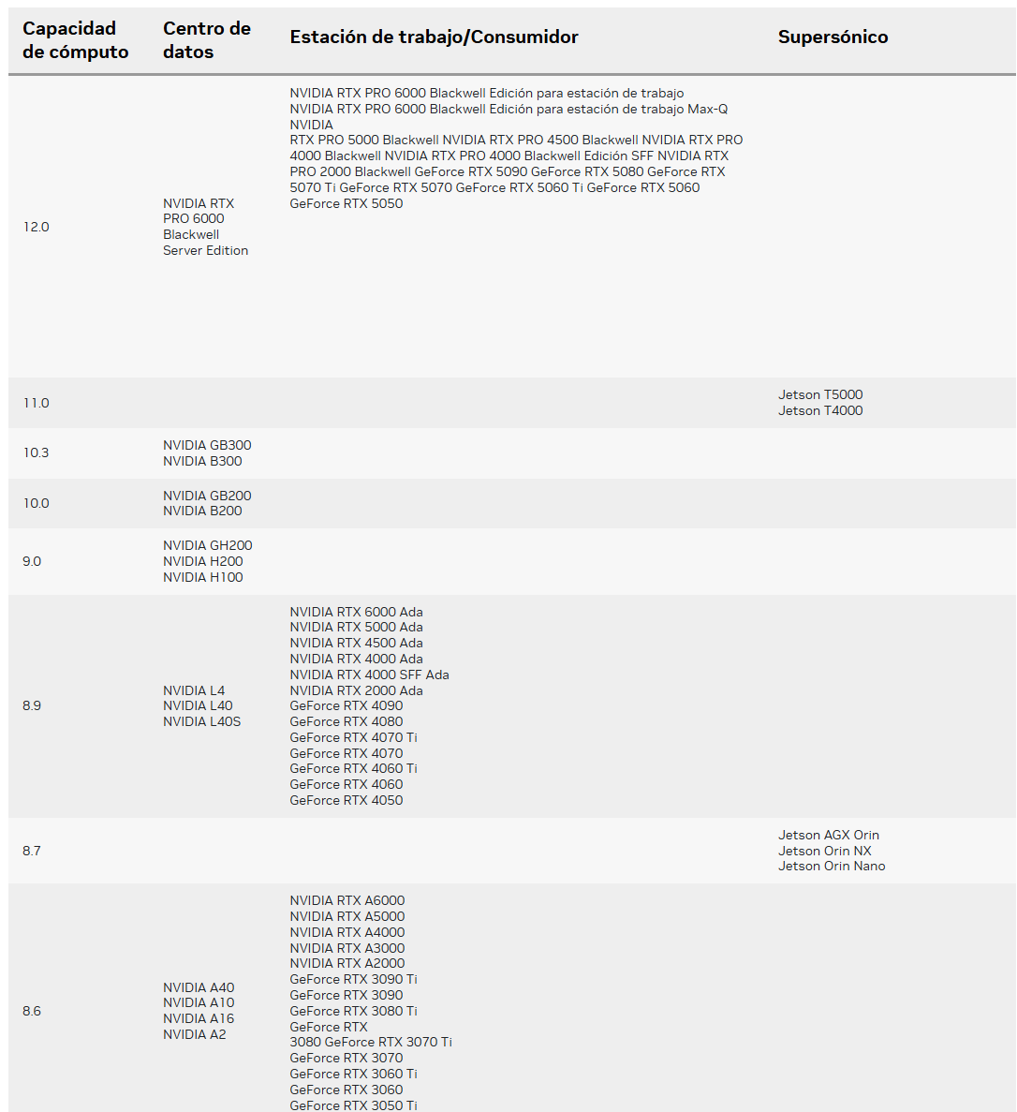
Compute Capability
Define the allowed functions and characteristics that the GPU can perform.
Each CUDA version require a minimum CC value
Some advance functions require also a minimum CC value
Tensor cores
Ray tracing
Acceleration FP16
Some libraries

Slide 6
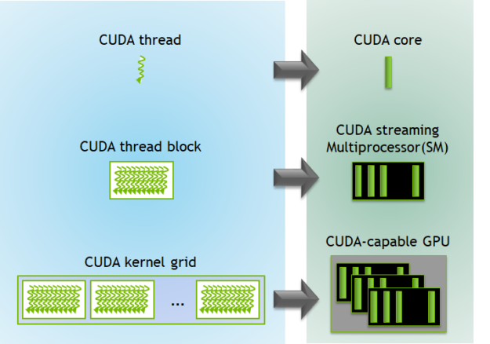
CUDA Kernel
Each thread execute a copy of the kernel

Slide 7
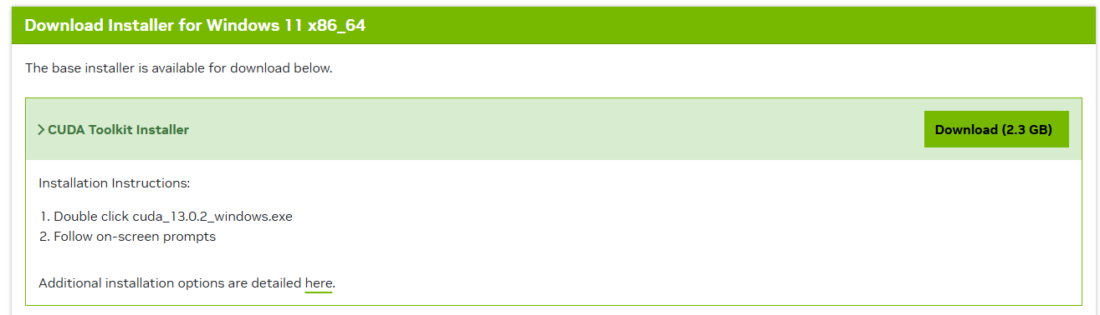
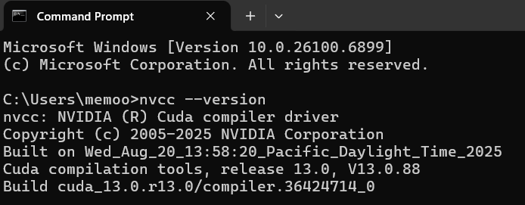
CUDA Toolkit
CUDA Toolkit
CUDA compiler nvcc
CUDA Libraries
CUDA Runtime
CUDA Driver APIs
CUDA Debugging
CUDA Performance Analysis
verify CUDA version
nvcc --version

Slide 8
RUN IN
COLAB

Slide 9
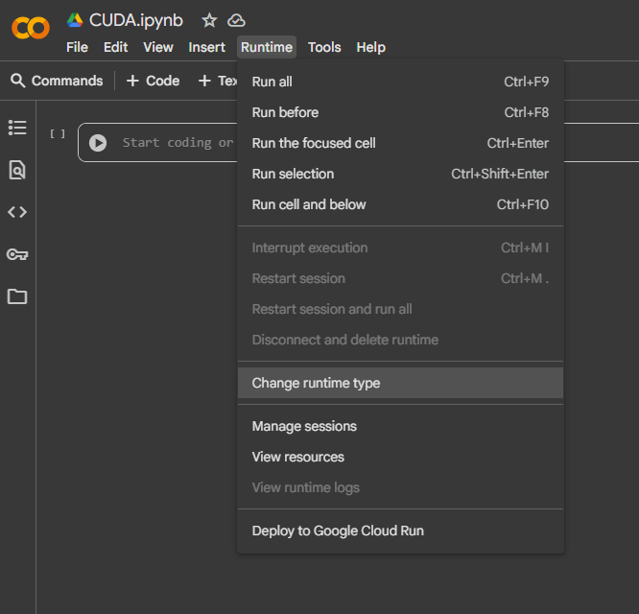
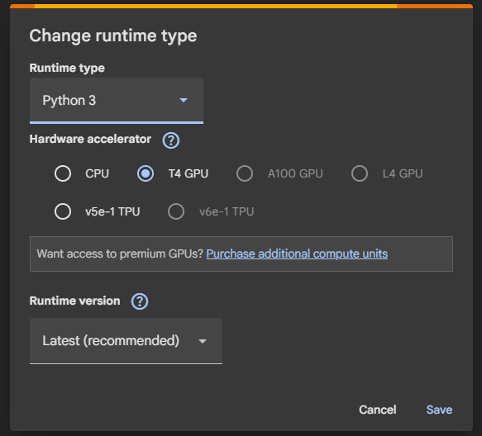
Set notebook to GPU

Slide 10
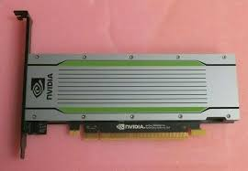
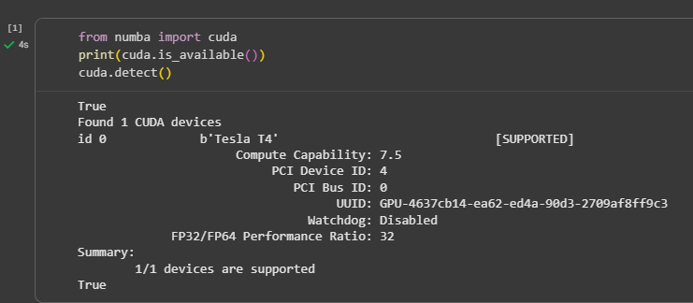
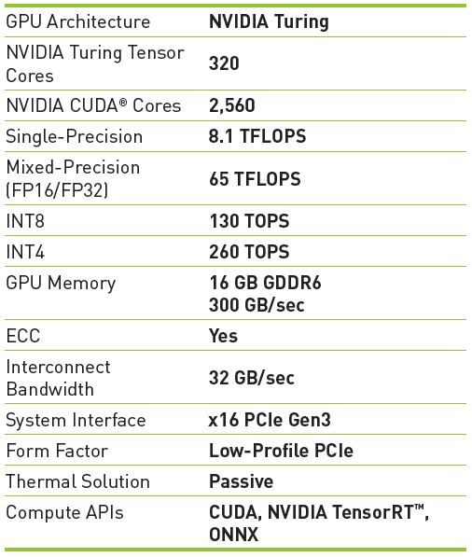
Hardware environment

Slide 11
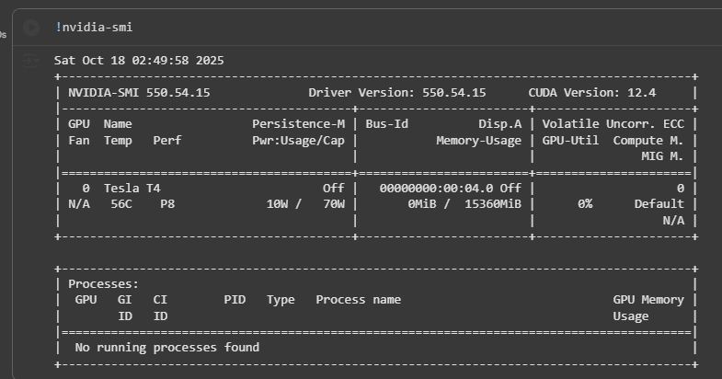
Hardware environment

Slide 12
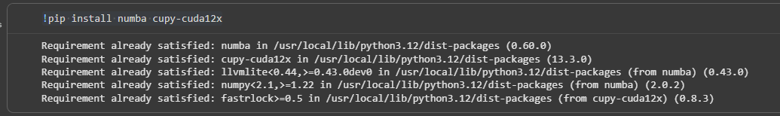
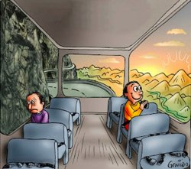
Stable version
!pip install numba cupy-cuda12x

Slide 13
Exercise 1

Slide 14
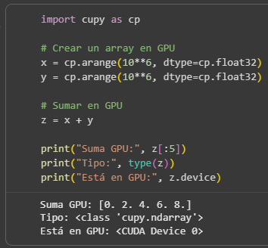
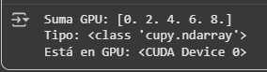
Hello world for GPU in CUPY
add 2 arrays containing 1M data each

Slide 15
Exercise 2

Slide 16
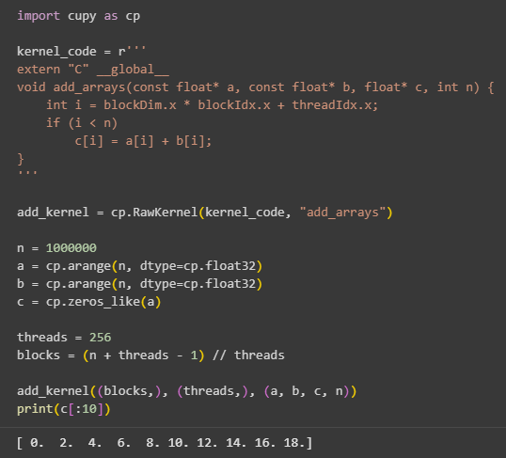

Hello world for CUDA kernel
add 2 arrays containing 1M data each
Each thread executes a copy of the kernel
each block contains 256 threads
(1M + 256 - 1) / 256 = 3907

Slide 17
use pure C
kernel
vector pointers
total size
thread
index
c vector storing results

Slide 18
Exercise 3
Image to black and white

Slide 19
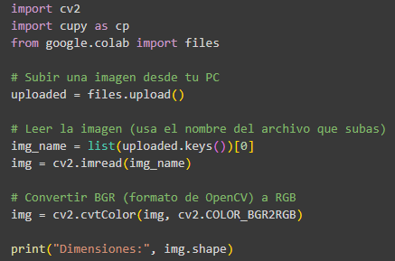
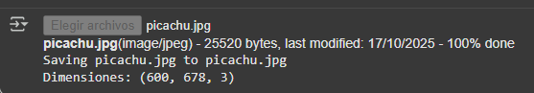
Image to grayscale
upload img file to RGB matrix

Slide 20
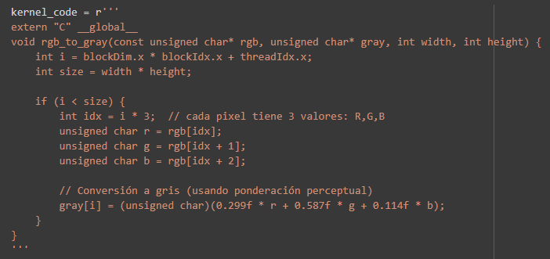
rgb: original image array
gray: result image array

Slide 21
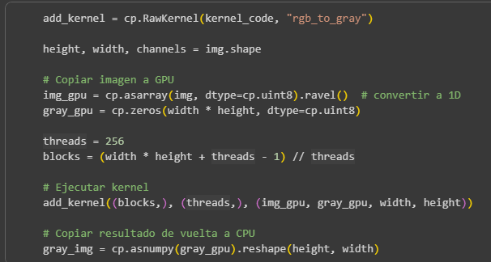
img matrix to array
result vector
result vector to image matrix

Slide 22
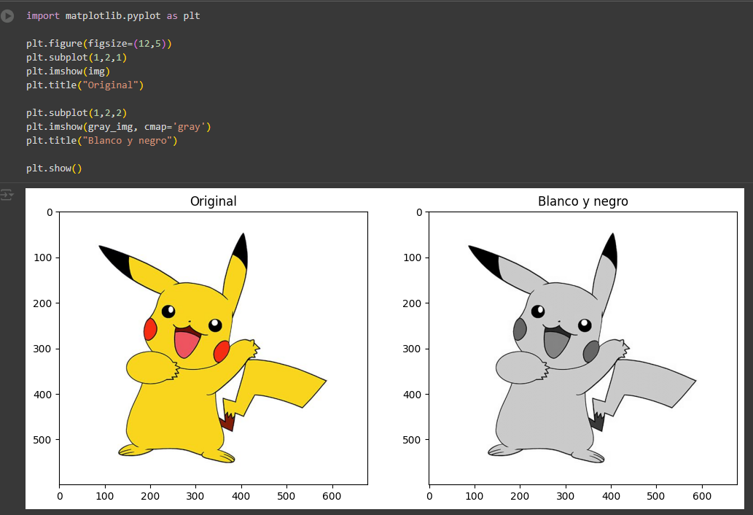

Slide 23
Workshop

Slide 24
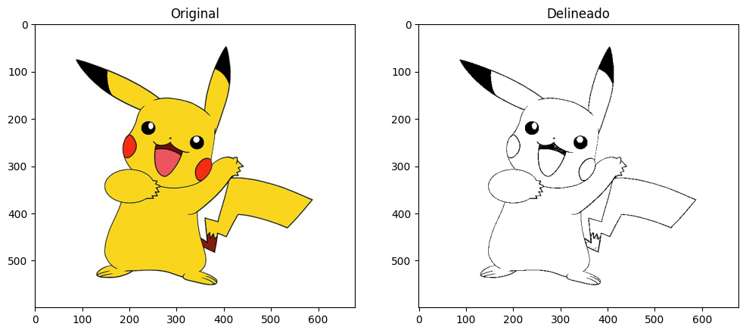
Image simple bordering

